Slide 1
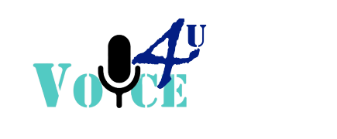
Group InNov8Q

Slide 2
Problem

Slide 3
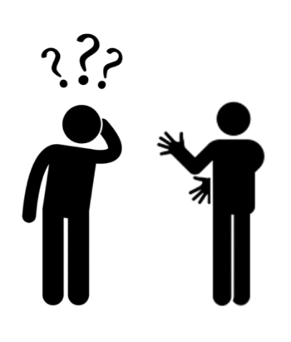
Does Everyone Know Sign Language?

Slide 4
Solution

Slide 5
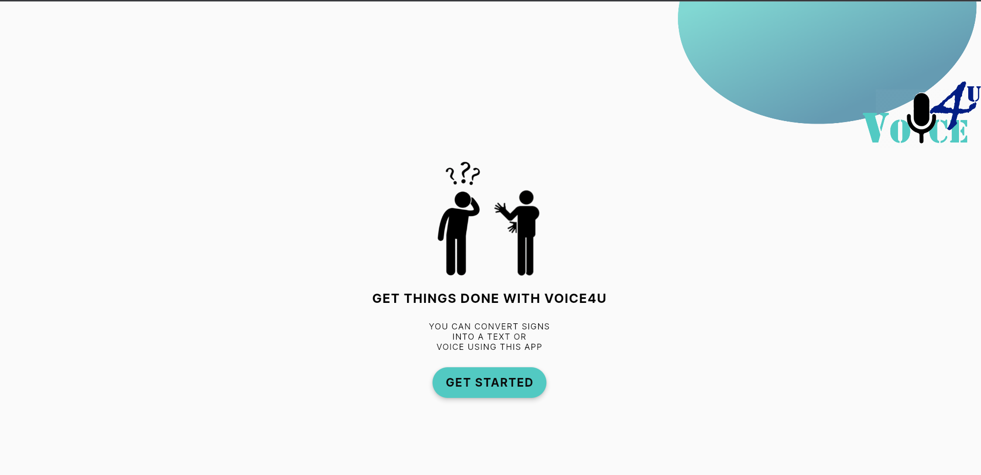
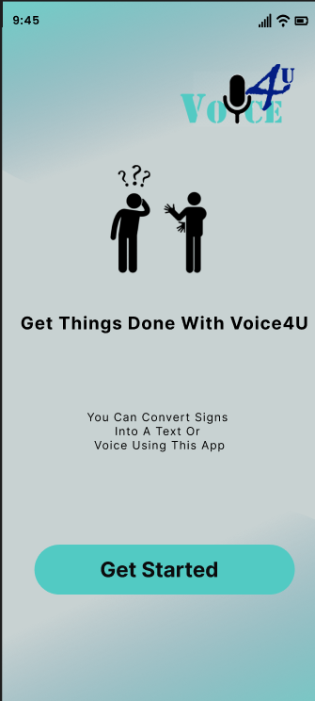
Action recognition & LSTM deep learning models
Translate sign language to text
Implemented in Python
Mobile Application
Translate text/voice messages to sign language images

Slide 6
FEATURES & FUNCTIONALITIES
Sign Language & Voice/Text Conversion
Mobile app - communicate between
Sign language users
Other users

Slide 7
Solution Architecture

Slide 8
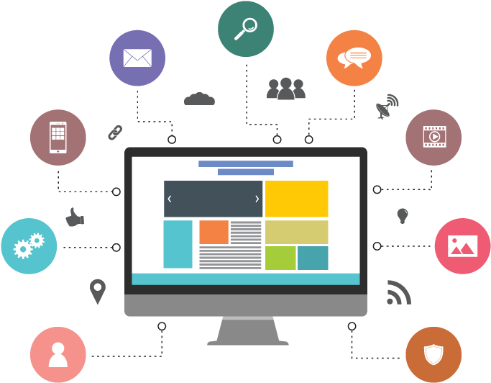

ML Model
Mobile
Application
Database

Slide 9
MODEL CREATION
1. Taking camera feed from the webcam or mobile camera
2. Taking Keypoints using MP Holistic
3. Extract Keypoint Values
4. Collect Keypoint Values for Training and Testing
5. Preprocess Data and Create Features
6. Build and Train LSTM Neural Network
7. Make Predictions
8. Send it to the application
9. Show information as needed by user

Slide 10
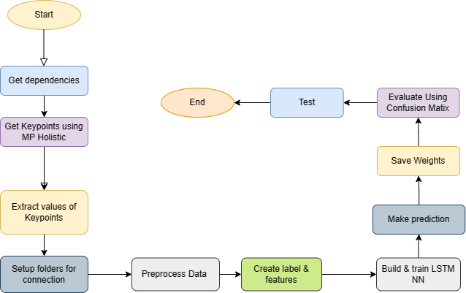
FLOW
CHART

Slide 11




TECHNOLOGIES

Slide 12
Software
Implementation
Mobile App – Figma

Slide 13
FEATURES OF OUR DESIGN
Can act as both mobile
& web applications
Real-time performance in communication
Communicate using
voice/ text as prefer
More precise & reliable sign language identification system
Translate text/voice to sign animation for sign language user

Slide 14
OUR CENTER
Demonstration
Do you know what helps you make your point clear? Lists like this one:
They’re simple
You can organize your ideas clearly
You’ll never forget to buy milk!

Slide 15
Thank You

Slide 16
Q & A

